Slide 1

Project Presentation SE: Arschloch
Group 5: Ralph Segi, Jan Kaiser

Slide 2
Table of content
Organisation:
Scrum
Git
TUI Development
GUI Development
MVC
Model/Controller Code Coverage
Design Patterns
Components & Interfaces
Dependency Injection

Slide 3
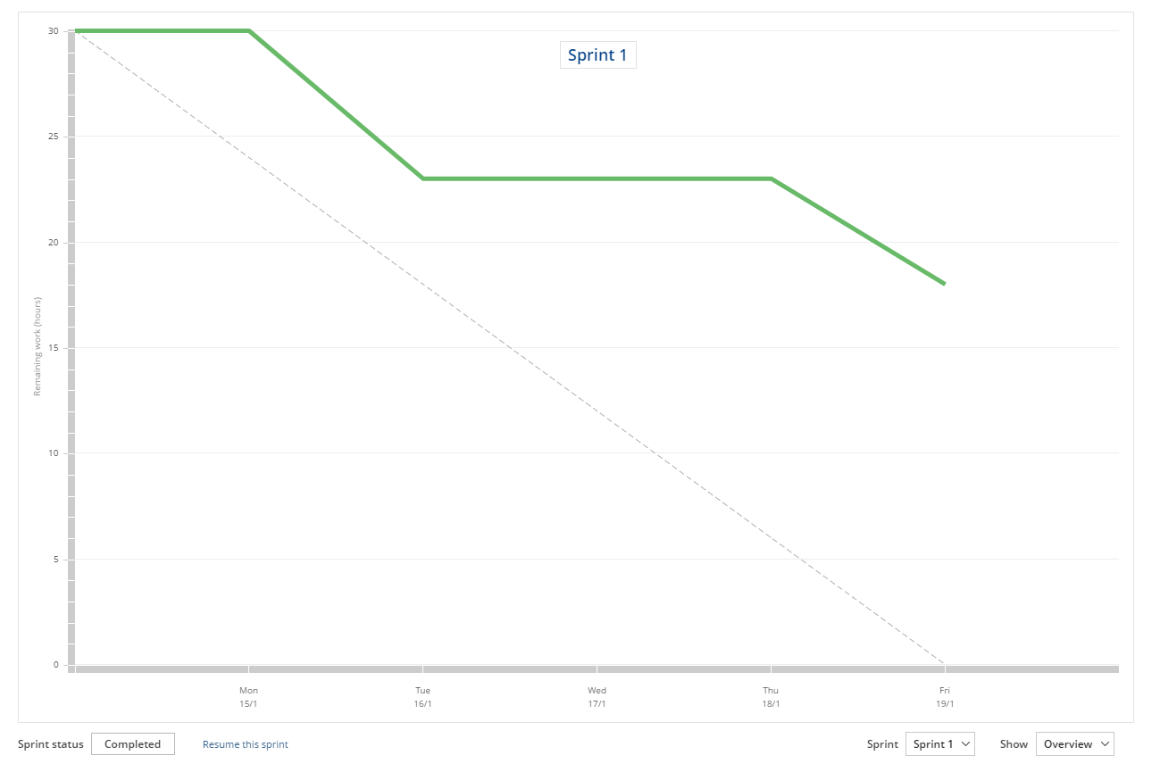
Scrum - Sprint 1

Slide 4
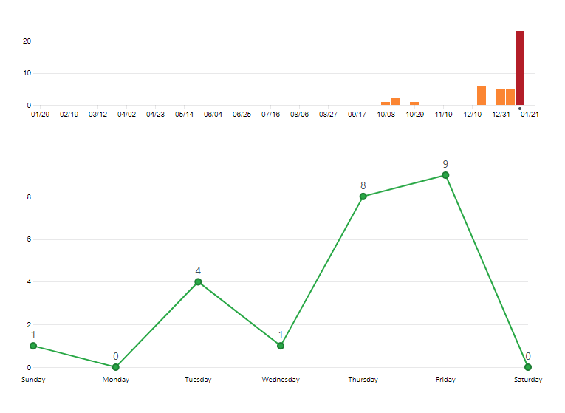
Git - Commits (Sprint 1)

Slide 5
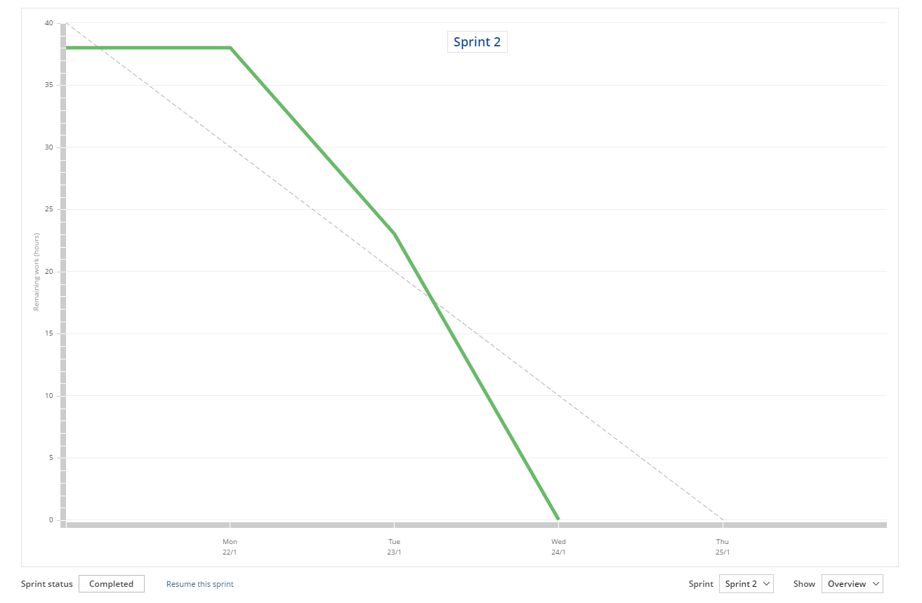
Scrum - Sprint 2

Slide 6
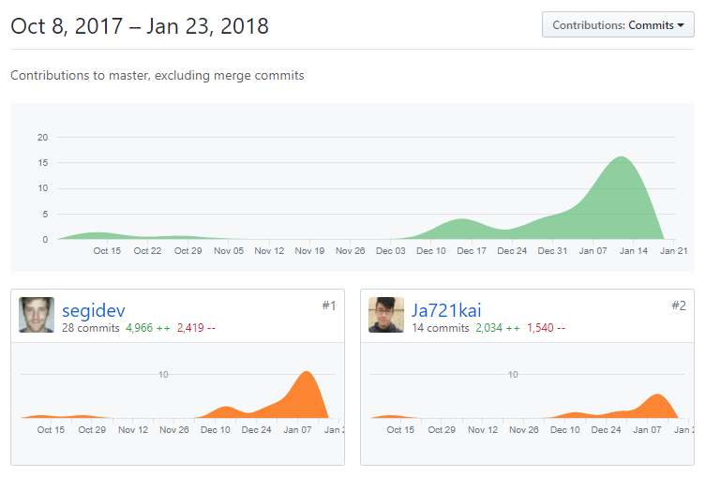
Git - Contributors

Slide 7
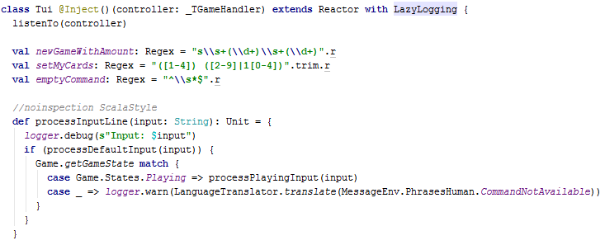
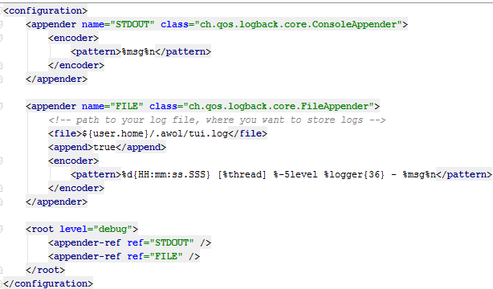
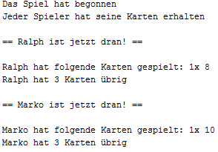
TUI Development
Injects the controller (our game handler)
Listens to the controller publisher
Affects also the GUI through the game handler
Uses backlog to write out to a file and the console (logback.xml example)

Slide 8
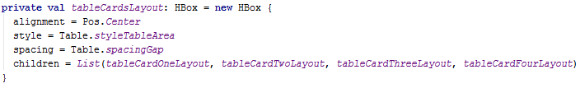

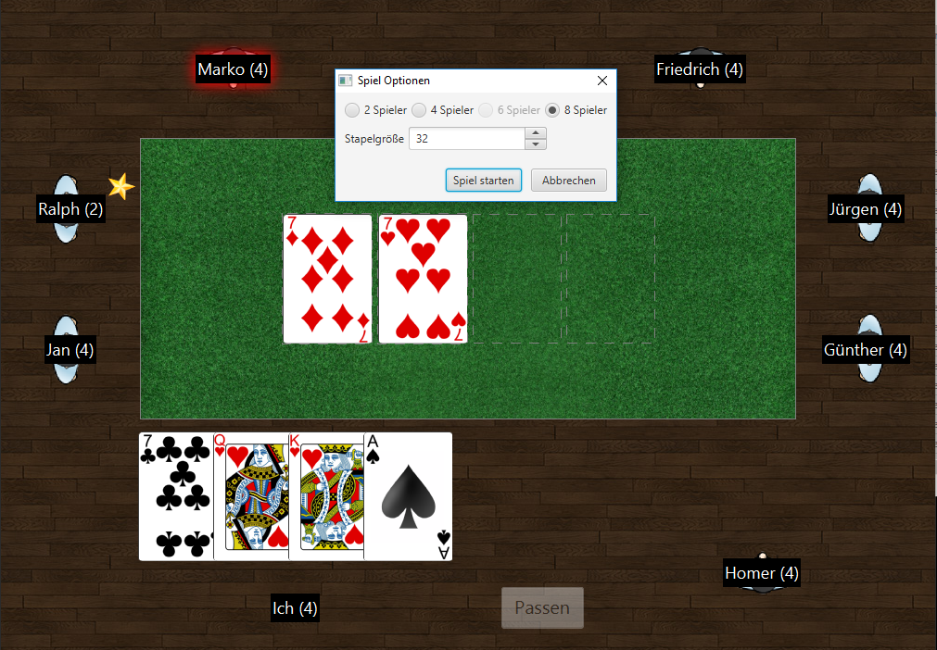
GUI Development
Uses ScalaFX merged into a swing frame
Forced us to make sure methods run in the FX Application Thread
Affects TUI (obviously)
ScalaFX offers awesome Properties that can be bound like that: Something <== Property()

Slide 9
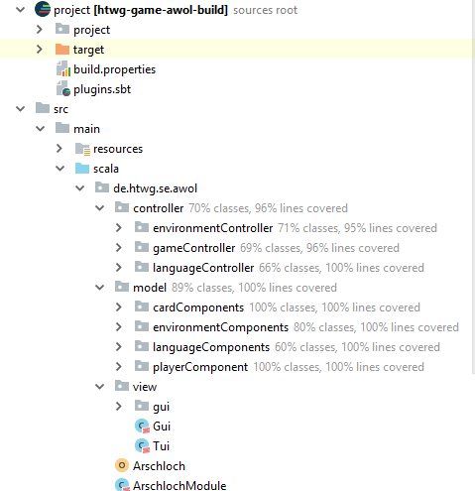
Model-View-Controller Architecture
environmentController:
Game Settings & JSON / XML
gameController:
controls game states
publish events
languageController:
controls translations Ger/Eng
Model contains languages, card structure, deck structure, languages, messages, gui images, player class
View contains GUI / TUI

Slide 10
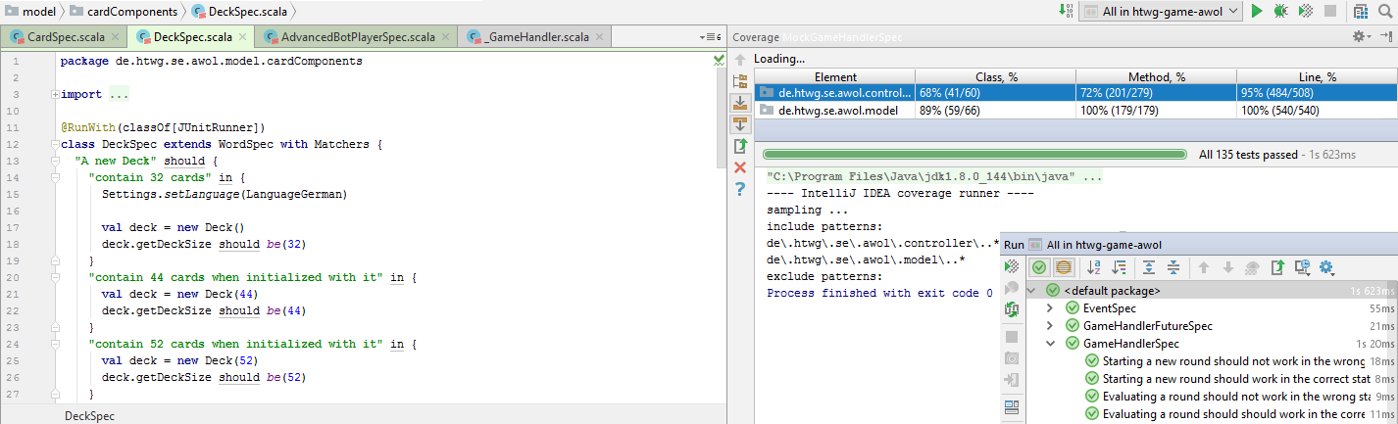
Code Coverage / Tests

Slide 11
Design Patterns
Observer
Singleton
Strategy

Slide 12
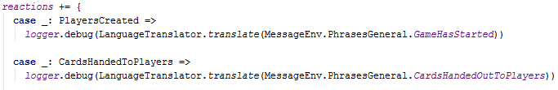

Observer Pattern
Observable
Observer
Uses scala.swing.Publisher to publish scala.swing.Event
Implemented in the game handler
Uses scala.swing.Reactor to receives scala.swing.Event
Implemented in the views (TUI and GUI)

Slide 13
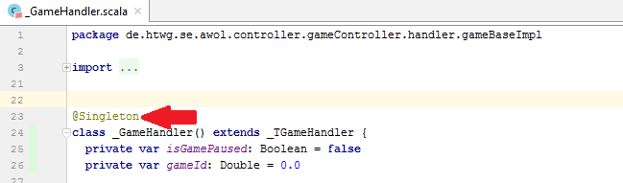
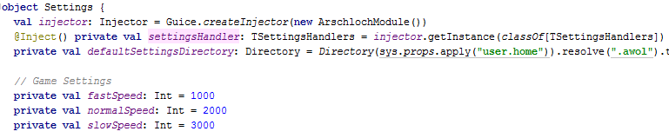
Singleton
Singleton through injection. @Singleton makes sure to inject only one instance to each „injector“
We also use Scala Objects to act as Singletons to handle eg. our game settings

Slide 14
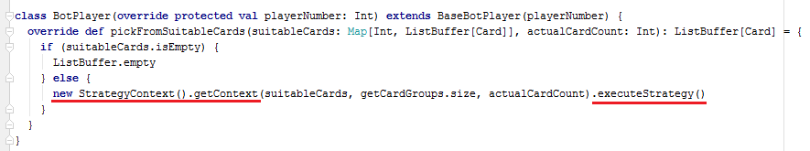
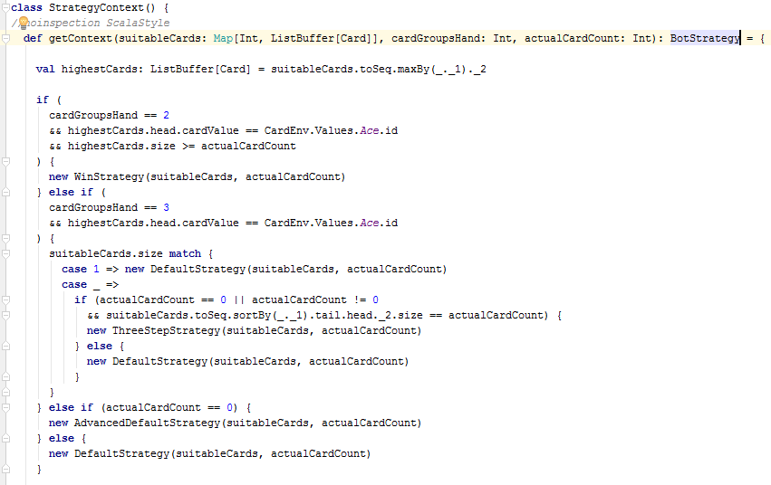
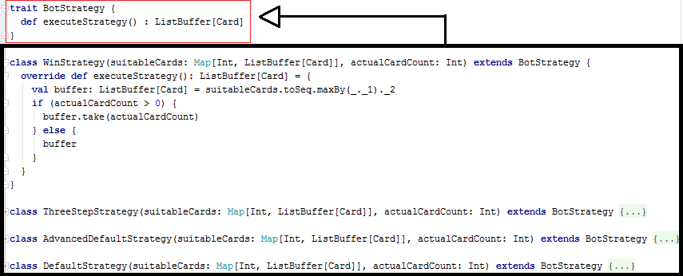
Strategy Pattern

Slide 15
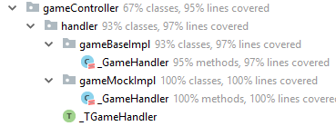
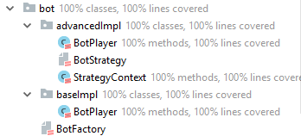
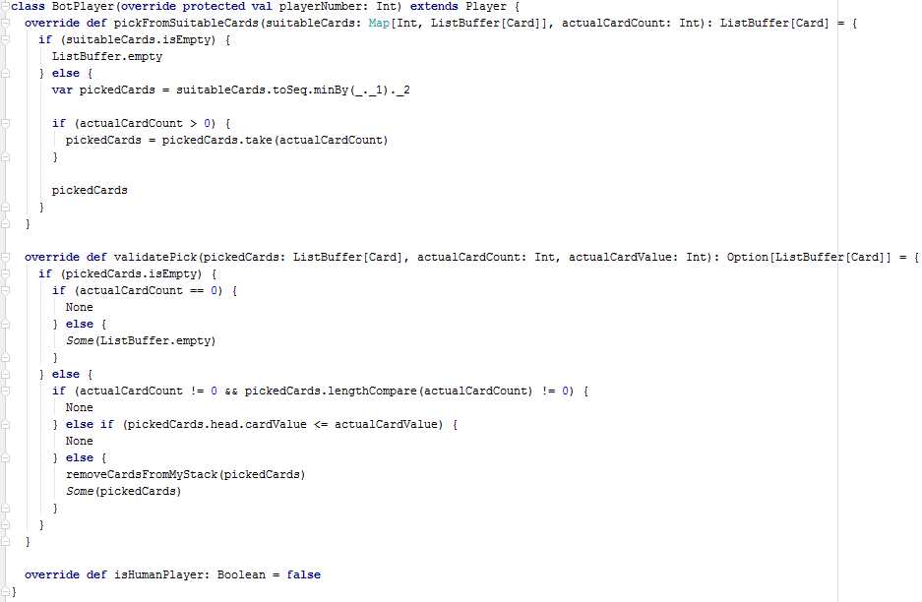
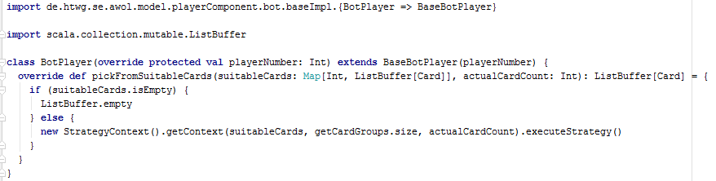
Components & Interfaces

Slide 16
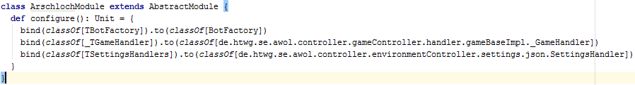
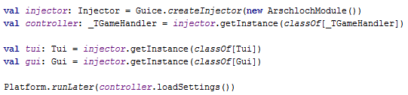
Dependency Injection
We create our Injection „manager“ with Google Guice
We dynamically load our gameHandler implementation which is injected into the TUI and GUI

